Slide 1
SQL FINAL PROJECT
INDIAN PREMIER LEAGUE
AUCTION

Slide 2
Creating ipl_ball table from ipl_ball data
Query:-
create table ipl_ball (id int, inning int, over int, ball int, batsman varchar, non_striker varchar,
bowler varchar, batsman_runs int, extra_runs int, total_runs int, is_wicket int,
dismissal_kind varchar, player_dismissed varchar, fielder varchar, extras_type varchar,
batting_team varchar, bowling_team varchar);
copy ipl_ball from 'C:\Program Files\PostgreSQL\16\data\IPL\IPL_Ball.csv' CSV header ;
select * from ipl_ball;
Creating ipl_matches table from ipl_matches data
Query:-
create table ipl_matches (id int, city varchar, date date, player_of_match varchar, venue varchar, neutral_venue int, team1 varchar, team2 varchar, toss_winner varchar, toss_decision varchar, winner varchar, result varchar, result_margin int, eliminator varchar, method varchar, umpire1 varchar, umpire2 varchar);
copy ipl_matches from 'C:\Program Files\PostgreSQL\16\data\IPL\IPL_matches.csv' CSV header ;
select * from ipl_matches;

Slide 3
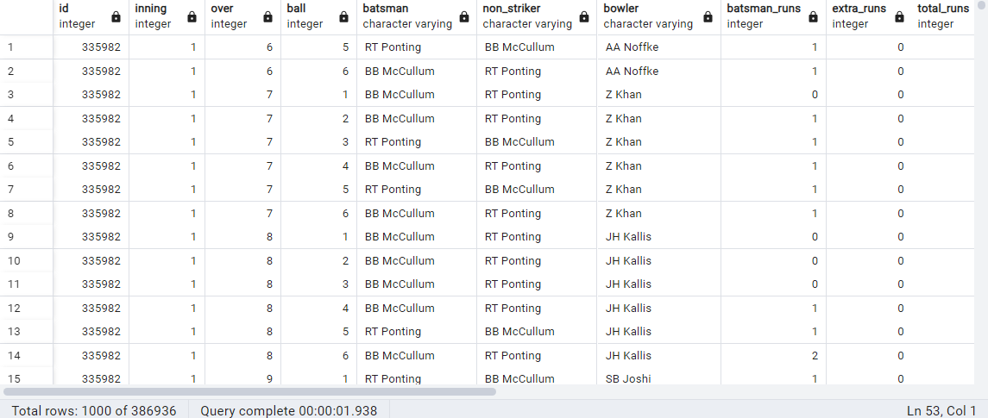
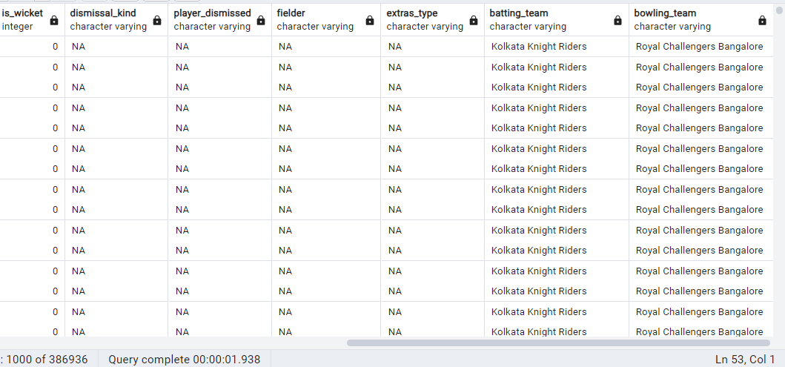
select * from ipl_ball;

Slide 4
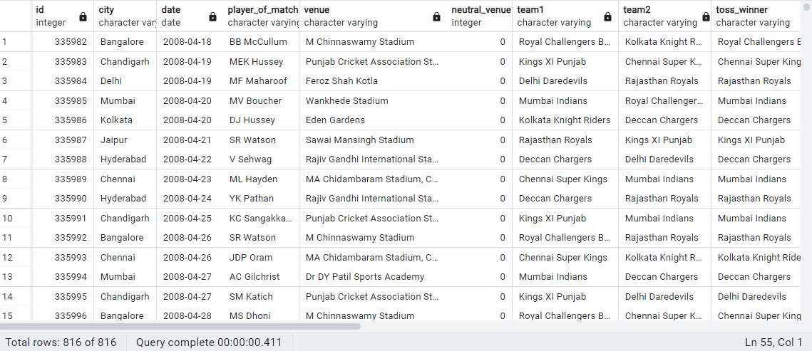
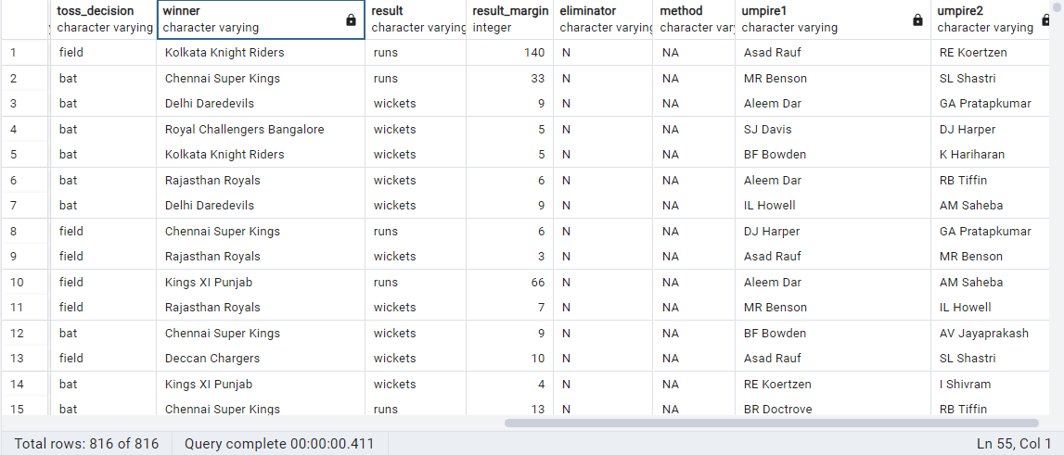
select * from ipl_matches;

Slide 5
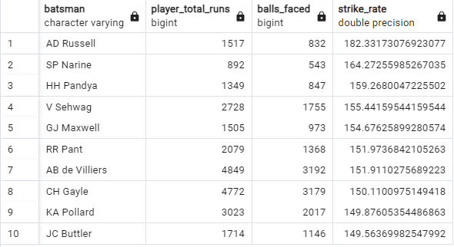
Q1:- Your first priority is to get 2-3 players with high S.R who have faced at least 500 balls and to do that you have to make a list of 10 players you want to bid in the auction so that when you try to grab them in auction you should not pay the amount greater than you have in the purse for a particular player.
Query:-
select batsman, player_total_runs, balls_faced, cast(player_total_runs as float)/balls_faced*100 as strike_rate from (select batsman,sum(batsman_runs) as player_total_runs, count(ball) as balls_faced from ipl_ball where not extras_type='wides' group by batsman) as a where a.balls_faced>500 order by strike_rate desc limit 10;

Slide 6
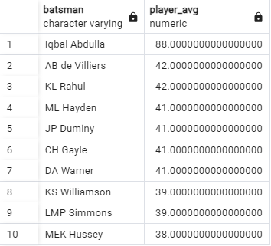
Q2:-Now you need to get 2-3 players with good Average who have played more than 2 ipl seasons.
And to do that you have to make a list of 10 players you want to bid in the auction so that when you
try to grab them in auction you should not pay the amount greater than you have in the purse for a
particular player.
Query:-
select batsman, avg(player_total_runs/dismissed_num) as player_avg from(select batsman, sum(batsman_runs) as
player_total_runs, sum(is_wicket) as dismissed_num,count(distinct extract(year from date)) as played_years from
(select a.batsman, a.batsman_runs, a.is_wicket, b.date from ipl_ball as a full join ipl_matches as b on a.id=b.id) as c
group by batsman) group by batsman,dismissed_num,player_total_runs,played_years having dismissed_num>=1 and
played_years>2 order by player_avg desc limit 10;

Slide 7
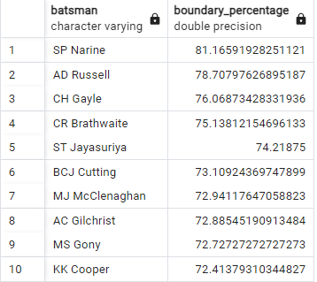
Q3:-Now you need to get 2-3 Hard-hitting players who have scored most runs in boundaries and have
played more the 2 ipl season. To do that you have to make a list of 10 players you want to bid in the
auction so that when you try to grab them in auction you should not pay the amount greater than
you have in the purse for a particular player.
Query:-
select batsman, (cast(boundary_runs as float)/total_runs*100) as boundary_percentage from (select batsman,total_runs,
sum(batsman_runs) as boundary_runs, count(distinct extract(year from date))as played_years from (select a.batsman,
a.batsman_runs, sum(a.batsman_runs) over (partition by a.batsman) as total_runs,b.date from ipl_ball as a full join
ipl_matches as b on a.id=b.id) as c where batsman_runs=4 or batsman_runs=6 group by batsman, total_runs) as d where
played_years>2 order by boundary_percentage desc limit 10;

Slide 8
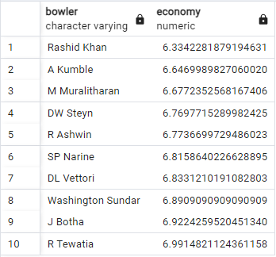
Q4:-Your first priority is to get 2-3 bowlers with good economy who have bowled at least 500 balls
in IPL so far. To do that you have to make a list of 10 players you want to bid in the auction so that
when you try to grab them in auction you should not pay the amount greater than you have in the
purse for a particular player.
Query:-
select bowler, conceded_runs/cast(bowled_overs as decimal) as economy from (select bowler,conceded_runs,bowled_balls,
count(ball)/6.0 as bowled_overs from (select bowler,over,ball, sum(total_runs) over (partition by bowler)as conceded_runs,
count(ball) over (partition by bowler) as bowled_balls from ipl_ball) as a where bowled_balls>500 group by bowler,
conceded_runs,bowled_balls)as b order by economy asc limit 10;

Slide 9
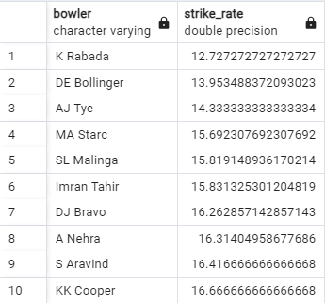
Q5:- Now you need to get 2-3 bowlers with the best strike rate and who have bowled at least 500
balls in IPL so far. To do that you have to make a list of 10 players you want to bid in the auction so
that when you try to grab them in auction you should not pay the amount greater than you have in
the purse for a particular player.
Query:-
select bowler, cast(bowled_balls as float)/wickets_taken as strike_rate from (select bowler,bowled_balls,sum(is_wicket)
as wickets_taken from (select bowler,is_wicket,count(ball) over (partition by bowler) as bowled_balls from ipl_ball) as a
where bowled_balls>500 and is_wicket>0 group by bowler,bowled_balls)as b order by strike_rate asc limit 10;

Slide 10
Q6:-Now you need to get 2-3 All_rounders with the best batting as well as bowling strike rate and
who have faced at least 500 balls in IPL so far and have bowled minimum 300 balls. To do that you
have to make a list of 10 players you want to bid in the auction so that when you try to grab them
in auction you should not pay the amount greater than you have in the purse for a particular player.
Query:-
create table batting_strikerate as (select batsman, player_total_runs, balls_faced, cast(player_total_runs as float)/balls_faced*100 as batting_sr from (select batsman,sum(batsman_runs) as player_total_runs, count(ball) as balls_faced from ipl_ball where not extras_type='wides' group by batsman having count(ball)>500) as a);
create table bowling_strikerate as (select bowler, cast(bowled_balls as float)/wickets_taken as bowling_sr from
(select bowler,bowled_balls,sum(is_wicket) as wickets_taken from (select bowler,is_wicket,count(ball) over (partition by bowler) as bowled_balls from ipl_ball) as a where bowled_balls>300 and is_wicket>0 group by bowler,bowled_balls)as b);
select a.batsman as all_rounder, cast(a.batting_sr as decimal), cast(b.bowling_sr as decimal) from batting_strikerate
as a inner join bowling_strikerate as b on a.batsman=b.bowler order by batting_sr desc, bowling_sr asc limit 10;

Slide 11
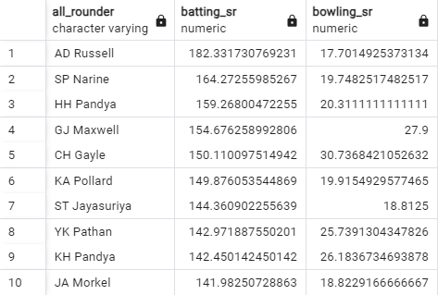

Slide 12
Wicketkeeper:
Having good fielding intelligence.
Reflexes and agility.
Batting strike rate > 120.
Bowling economy <10.
Adaptability.
Played more than 2 IPL seasons.

Slide 13
Additional Questions for Final Assessment
Creating deliveries table from ipl_ball data
Query:-
create table deliveries (id int, inning int, over int, ball int, batsman varchar, non_striker varchar, bowler varchar,
batsman_runs int, extra_runs int, total_runs int, is_wicket int, dismissal_kind varchar, player_dismissed varchar,
fielder varchar, extras_type varchar, batting_team varchar, bowling_team varchar);
copy deliveries from 'C:\Program Files\PostgreSQL\16\data\IPL\IPL_Ball.csv' CSV header ;
select * from deliveries;
Creating matches table from ipl_matches data
Query:-
create table matches (id int, city varchar, date date, player_of_match varchar, venue varchar, neutral_venue int,
team1 varchar, team2 varchar, toss_winner varchar, toss_decision varchar, winner varchar, result varchar, result_margin int, eliminator varchar, method varchar, umpire1 varchar,umpire2 varchar);
copy matches from 'C:\Program Files\PostgreSQL\16\data\IPL\IPL_matches.csv' CSV header ;
select * from matches;

Slide 14
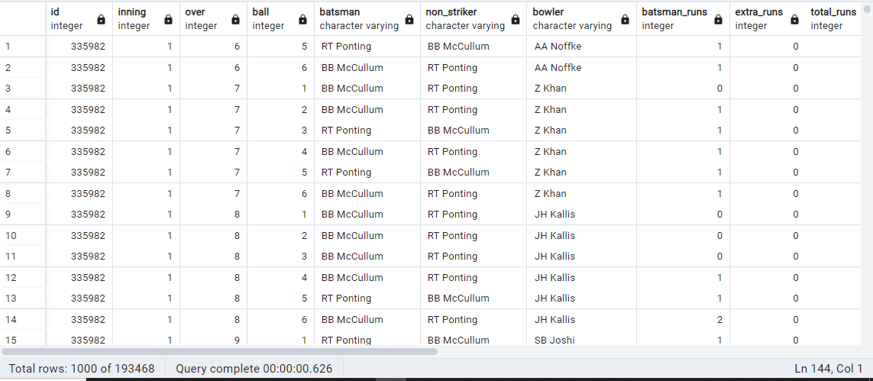
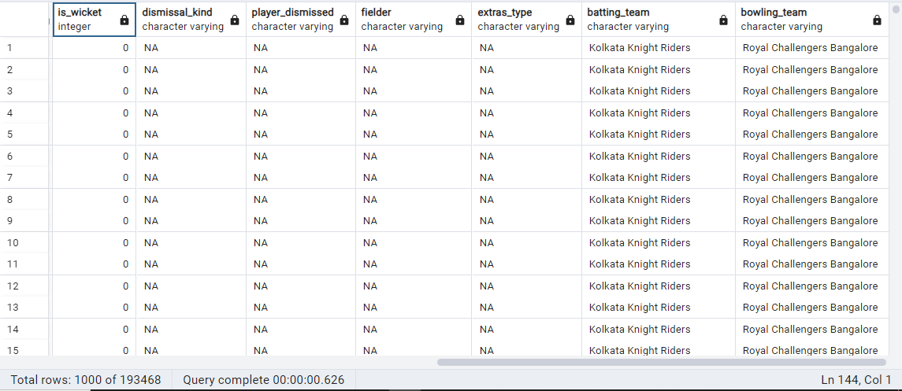
select * from deliveries;

Slide 15
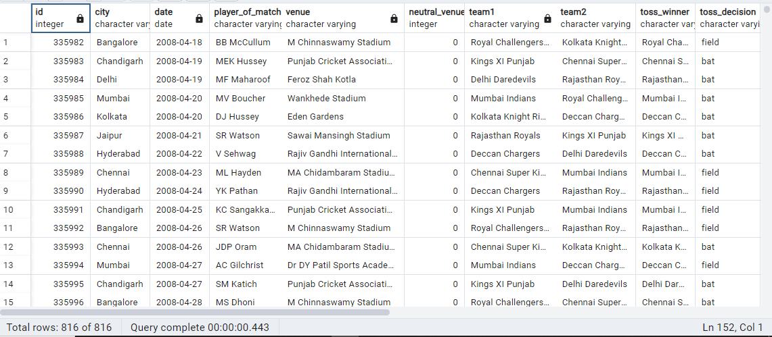
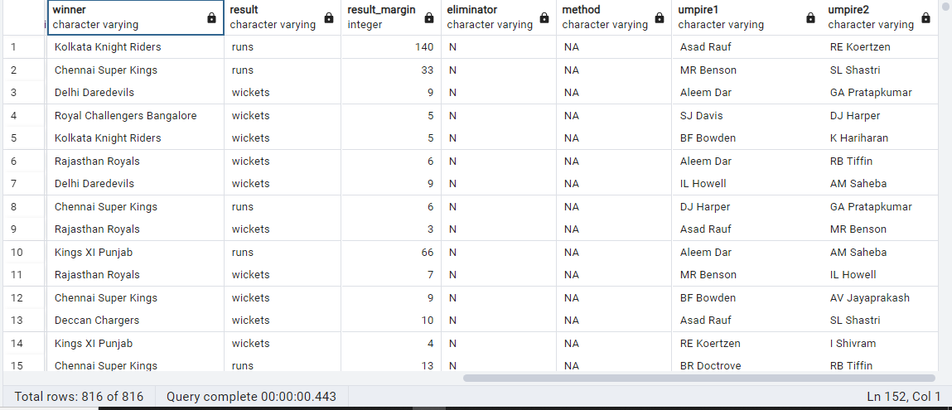
select * from matches;

Slide 16

Get the count of cities that have hosted an IPL match
Query:-
select count(distinct city) from matches;

Slide 17
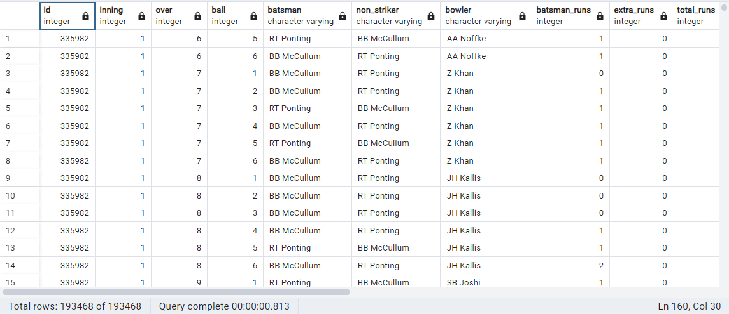
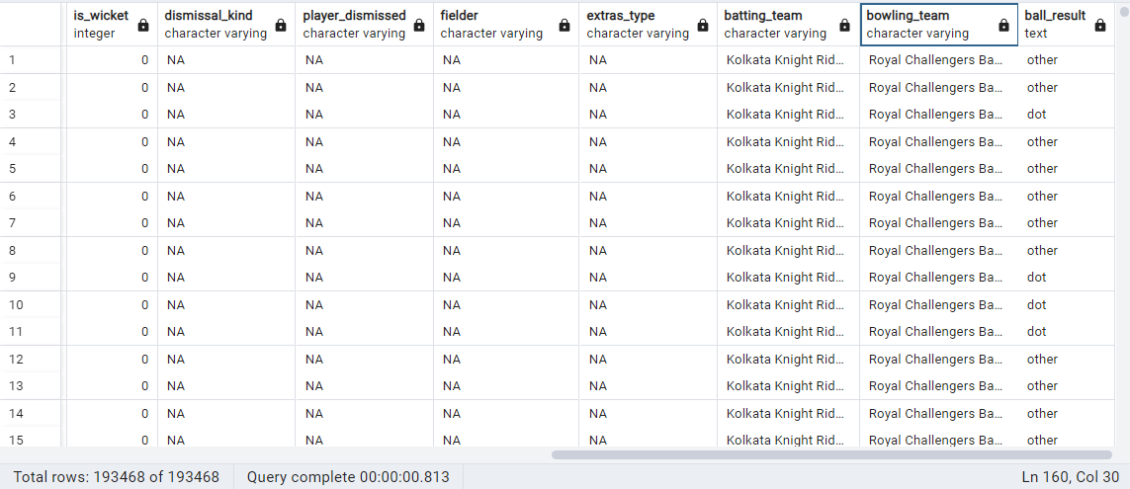
2. Create table deliveries_v02 with all the columns of the table ‘deliveries’ and an additional column ball_result containing values boundary, dot or other depending on the total_run (boundary for >= 4, dot for 0 and other for any other number)
Query:-
Create table deliveries_v02 as (select *, case when total_runs>=4 then 'boundary' when total_runs=0 then 'dot'
Else 'other' end as ball_result from deliveries);
Select * from deliveries_v02;

Slide 18
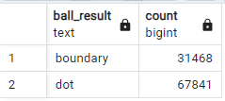
3. Write a query to fetch the total number of boundaries and dot balls from the deliveries_v02 table.
Query:-
select ball_result, count(ball_result) from deliveries_v02 where ball_result='boundary' or ball_result='dot'
group by ball_result;

Slide 19
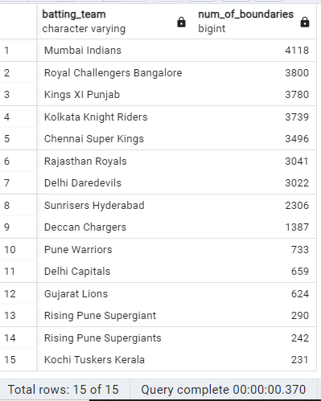
4. Write a query to fetch the total number of boundaries scored by each team from the deliveries_v02 table and order it in descending order of the number of boundaries scored.
Query:-
select batting_team, count(ball_result) as num_of_boundaries from deliveries_v02 where ball_result='boundary'
group by batting_team order by num_of_boundaries desc;

Slide 20
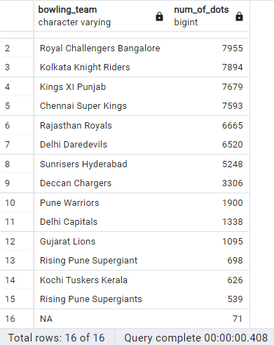
5. Write a query to fetch the total number of dot balls bowled by each team and order it in descending order of the total number of dot balls bowled.
Query:-
select bowling_team, count(ball_result) as num_of_dots from deliveries_v02 where ball_result='dot'
group by bowling_team order by num_of_dots desc;

Slide 21
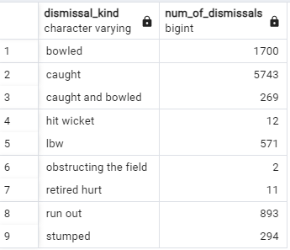
6. Write a query to fetch the total number of dismissals by dismissal kinds where dismissal kind is not NA
Query:-
select dismissal_kind, count(dismissal_kind) as num_of_dismissals from deliveries_v02 where not dismissal_kind='NA' group by dismissal_kind;

Slide 22
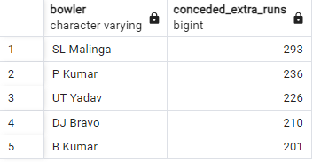
7. Write a query to get the top 5 bowlers who conceded maximum extra runs from the deliveries table.
Query:-
select bowler, sum(extra_runs) as conceded_extra_runs from deliveries_v02 group by bowler
order by conceded_extra_runs desc limit 5;

Slide 23
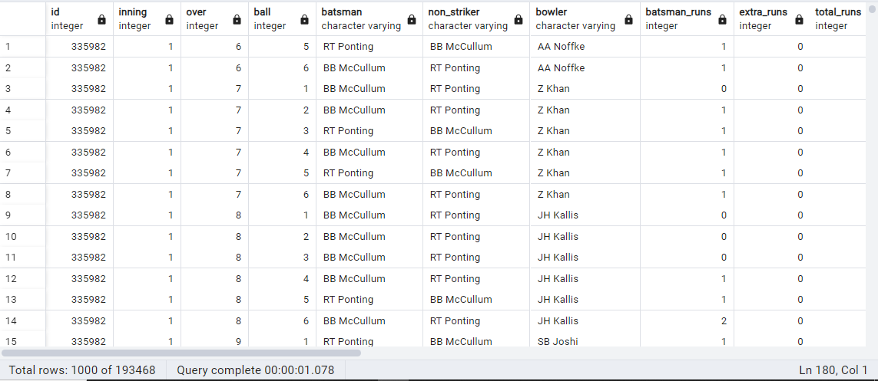
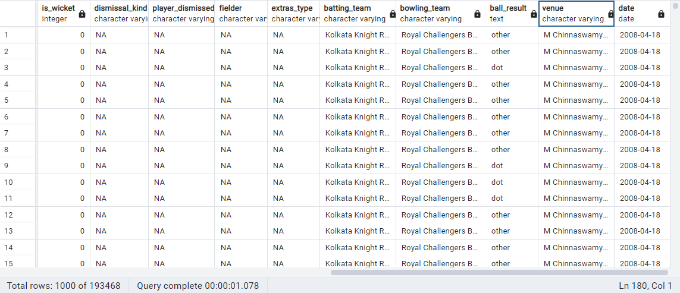
8. Write a query to create a table named deliveries_v03 with all the columns of deliveries_v02 table and two additional column (named venue and match_date) of venue and date from table matches.
Query:-
create table deliveries_v03 as (select a.*,b.venue,b.date from deliveries_v02 as a full join matches
as b on a.id=b.id);
select * from deliveries_v03;

Slide 24
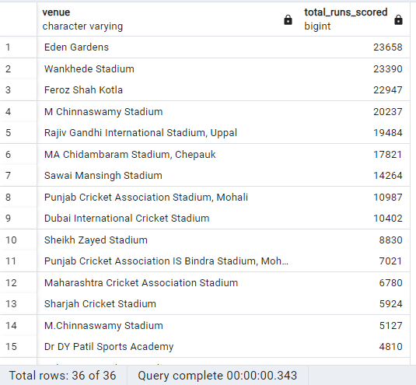
9. Write a query to fetch the total runs scored for each venue and order it in the descending order of total runs scored.
Query:-
select venue, sum(total_runs) as total_runs_scored from deliveries_v03 group by venue order by total_runs_scored desc;

Slide 25
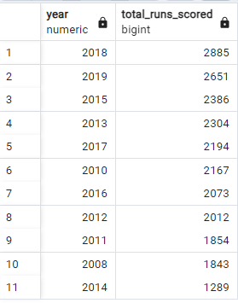
10. Write a query to fetch the year-wise total runs scored at Eden Gardens and order it in the descending order of total runs scored.
Query:-
select distinct extract(year from date) as year, sum(total_runs) as total_runs_scored from deliveries_v03
where venue='Eden Gardens' group by year order by total_runs_scored desc;

Slide 26
THANK YOU

